Slide 1
AMI Utility Modernization
max growth
Atta Boateng
DATA 607

Slide 2
What is AMI?
Advanced Meter Infrastructure other known as AMI is hardware with software that tracks a user’s real-time utility data and compiles a report for them to view to energy consumption

Slide 3
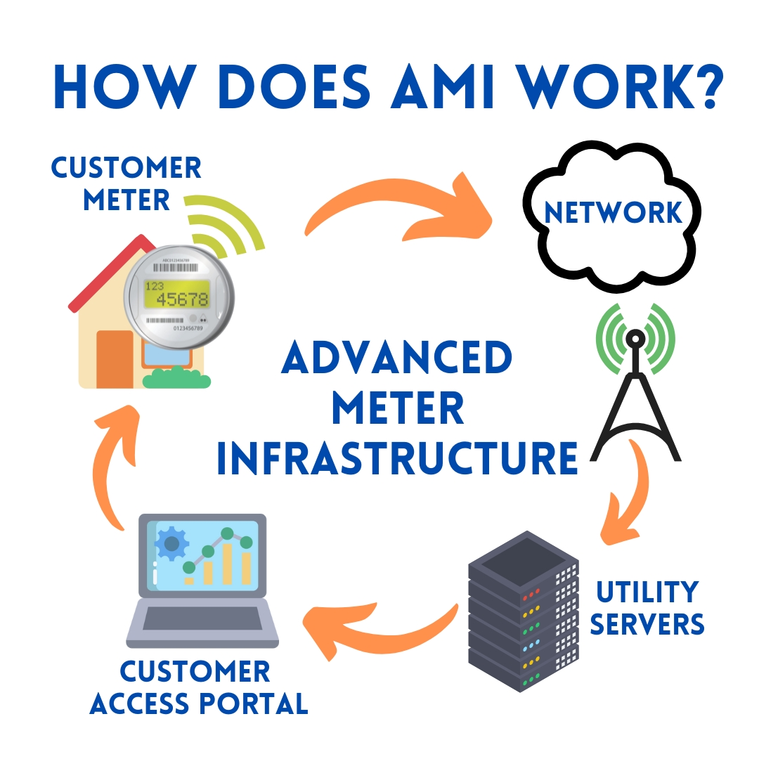
Company

Slide 4
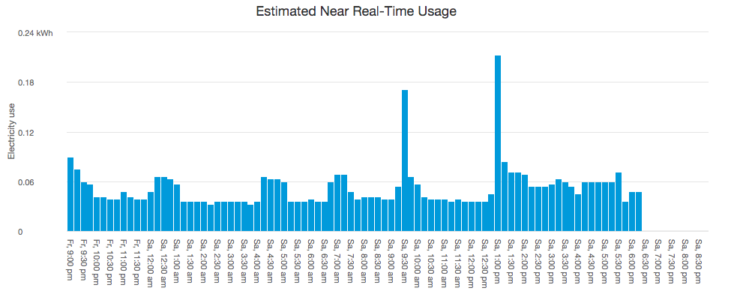
Company

Slide 5
Benefits of energy data
Customers can see their total energy consumption for the month
Adjust their energy usage to reduce monthly cost
Estimated cost in customer billing
Resource allocation for peak usage hours

Slide 6
Business Use Cases
Customer Service
Outage Response
Billing Forecast
Inconsistent and/or inaccurate meter data may lead to bill increases which may lead a loss in credibility
Loss signal of meter data for a period of time can be a sign of lost of service
Business is able to predict a customer’s expected energy usage based on past meter data which can play a role in operating expenses for energy rates

